Slide 1

Supervisor Nuts & Bolts
The University of Akron School of Speech-Language Pathology
and Audiology
Q & A about all kinds of stuff that’s not in the handbook.

Slide 2

What is the typical schedule for a student externship?
A typical Fall or Spring extern rotation is 16 weeks, and students typically attend 5 days per week, including Finals Week.
Students usually attend their extern site for a full working day.
Summer extern rotations may have a different schedule; will be arranged by externship placement coordinator

Slide 3
Is this always the case?
There are occasional exceptions when a student might have a shorter rotation or less days per week.
  This can be due to specialized training grants, internships, the request of the extern site or supervisor or other circumstances.
Prior approval from the Extern Coordinator is needed to have an atypical schedule.

Slide 4

How many clock hours should a student get in a semester?
ASHA training standards do not specify a total number of hours a student must accrue during an extern rotation, nor do they specify that clock hours be gained in specific categories.
Typically, a student who is in a full time 15-16 week rotation will earn around 100-150 or more clock hours during a semester.

Slide 5
Clinical Competency vs. Clock Hours
While our students are required to gain 400 clock hours prior to graduation, we’d like to emphasize that the extern rotation focus should be on clinical competencies and not a specific number of clinical clock hours or number of days spent at the extern site.

Slide 6
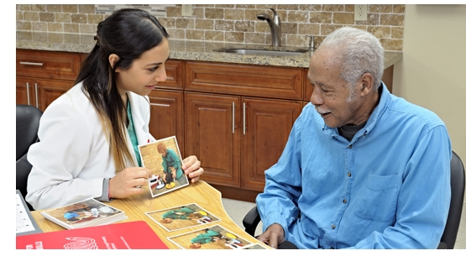
How much clinical experience do the students have before they do an extern rotation?
SLP students will usually have three or four semesters of clinical experience prior to an extern rotation.
Students who are on specialized training grants or who are off-sequence in the program may have two to four prior semesters of clinic experience.

Slide 7
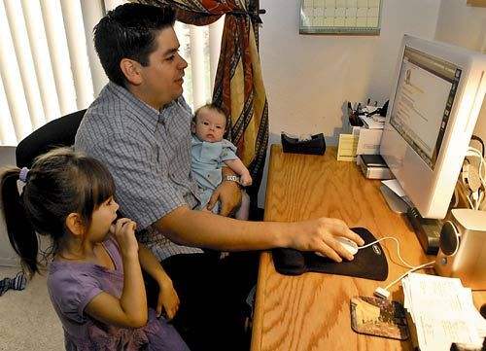
Are students different these days?
Yes! We have many non-traditional students in both our campus residential program and our Distance Learning program.

Slide 8
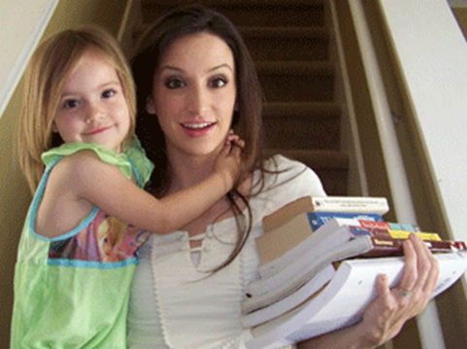
Who is a non-traditional student?
Typically older in age
May have had a previous career in another field
Has responsibilities of children, spouses/partners, aging parents, some degree of employment, etc.
Because of all of the above, they are typically very good with time management and balancing their responsibilities.

Slide 9
How soon should students start seeing clients?
Each student brings differing sets of skills and clinical experiences to an extern site. The supervisor will need to be aware that some students are ready to undertake responsibilities more quickly than others.
We expect that for the first one to two weeks the student will be observing/shadowing the SLP supervisor as she/he serves the caseload.

Slide 10
Seeing clients, cont’d…
We encourage the supervisor to allow the students to assume direct service delivery with clients by about week two or three for a portion of the caseload.
During weeks three to eight, the student should increase the percentage of the caseload that they are serving
By week eight (mid-term in the semester) they are serving a majority of or the entire caseload.

Slide 11
What are the policies on absences?
Students are expected to be at their extern sites on a regular schedule agreed upon by the supervisor and the student at the start of the rotation. Illness or family emergencies are the only acceptable reasons for absences.
If a student misses three or more consecutive days due to illness, documentation from a physician is required.
Students are NOT allowed to take a vacation during an externship.

Slide 12
Absences, cont’d…
If a student misses five or more days during the externship, these missed days will need to be made up based upon a mutually agreed upon schedule.
Make up days could extend past the end of a semester; this is not an issue, as final grades can be entered at any time.

Slide 13
Absences, continued…
Students are also expected to be at the extern site on the agreed upon days of the week and the length of day agreed upon.
If a student is not adhering to the schedule or is not staying at the site for the agreed upon hours, the Clinical Coordinator must be notified.

Slide 14
What is a full day?
It is expected that students:
  …arrive at their site with adequate time to set up and prepare for therapy.
  …implement the full day of treatment per the caseload
  …remain at the site at the end of the day to complete documentation, attend team meetings, attend IEP meetings, participate in parent conferences, etc.

Slide 15
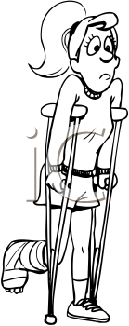
How do we handle extended absences?
If a student must be absent from an extern site for an extended period of time (severe illness, an accident, extreme family emergency, etc.) the Clinical Coordinator must be notified.
The decision of what to do regarding the remainder of the rotation will need to be made on a case-by-case basis.

Slide 16

What about snow days/calamity days?
If an extern site is closed due to inclement weather, power outages, water problems or any other reasons, the student is not required to attend and it should not count against them in any way; they are not required to make up the day(s).

Slide 17
Religious obligations
Students are allowed to take time off from clinicals for religious holiday/reasons, but it does not relieve them of the duty to accrue clinical hours or to make up the time missed. Students are required to provide advance notice so the time can be rescheduled before the end of the rotation.

Slide 18
Can a supervisor ask for extra time from the student?
Some supervisors request that student come to their extern sites on days when they are not scheduled to be there, for various reasons. Supervisors need to be aware that many of our students have internship obligations, a part-time job, graduate assistant duties, child care issues or other essential responsibilities on those off days and they should not be expected to attend or have any penalty in their evaluation.

Slide 19
Supervisor absences:
The SLP supervisor must be onsite at all times when a student is delivering direct therapy services.
If the supervisor is absent, the student may not see clients unless another licensed SLP supervisor is available for direct supervision. (In-person or e-supervision.)
However, if the supervisor is absent, the student may attend that day, but engage only in indirect therapy services such as documentation, observation of other professionals, therapy prep, and so on.

Slide 20

What are the UA start and end dates?
The UA calendar changes each year
The Fall semester generally begins during the third or fourth week in August and runs until early to mid December.
The Spring semester generally begins during the second or third week in January and runs until early to mid May.

Slide 21
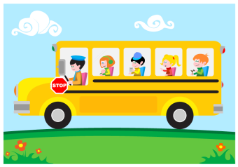
When should students start and stop their extern rotations?
For school externships:
  Students will attend their extern site following the official UA calendar.
  However, students may volunteer to begin their school placement earlier than this in order to benefit from activities such as screenings, establishing schedules, consultation with teachers, reviewing IEPs, etc.
  Students are still expected to stay at their site through Finals Weeks.

Slide 22
Start and Stop, cont’d…
For medical externships:
  Students will attend their extern site following the official UA calendar.
  Students are expected to stay at their site through Finals Weeks.

Slide 23
What are the guidelines for University breaks during a school externship?
The student should attend their externship when the school is open.
Confusion arises with school extern site breaks that differ from the UA breaks, particularly UA Spring Break.
If the UA Spring Break week does not align with the school district Spring Break dates, then the student is expected to attend their externship when their school site is in session.
During the school’s Spring Break, students are expected to attend regularly scheduled classes at UA.

Slide 24
What are the guidelines for University breaks during a medical externship?
The student should attend their externship when the medical site is open, with the exception of UA Spring Break. Students are permitted to be absent from their externship during UA Spring Break. The student is expected to notify their supervisor of the dates of this break in advance.

Slide 25
Who you gonna call…?
If at any time you have any concern, no matter how small, please contact the Externship Coordinator
SLP Clinic Director and Medical Extern Coordinator:
  Denise Simcox: 330-972-4260, dsimcox@uakron.edu
School Extern Coordinator:
  Jennifer Gibbs: 330-972-4329, jgibbs @uakron.edu
Distance Learning Coordinators:
  Caitlin Perry: 330-972-4667, cperry@uakron.edu
  Steffany Wechter: 330-972-5153 swechter@uakron.edu

